Slide 1

Department of Computer Science & Engineering Internship Project Presentation
Customer Segmentation:
Using clustering algorithms to segment customers
for a retail business
BY
prajwal s(1db20cs085 )
Under the guidance of
Prof. Ranjeeth kumar

Slide 2
ABOUT THE COMPANY
FreshersLabs is an exclusive edu-tech training & job placement company.
FreshersLabs specially focuses on freshers to make them job ready by providing training with top trending technologies & Internships.
FreshersLabs primary objective is to make fresh college graduates Job-ready by skilling them up with top trending technologies and Internship programs during the course of the academics itself.

Slide 3
INTRODUCTION
Customer segmentation is the process of dividing a customer base into distinct groups based on shared characteristics.
This allows businesses to tailor their products, services, and marketing strategies to better meet the specific needs of each segment, ultimately improving customer satisfaction and business performance.

Slide 4
PROBLEM DEFINITION
In order to optimize marketing strategies, product offerings, and customer experiences, and aims to effectively segment diverse customer base.
By clustering algorithms, seek to group customers with similar characteristics, behaviors, and preferences into distinct segments. The goal is to enhance ability to target and engage customers with tailored approaches that meet their specific needs.

Slide 5
LITERATURE SURVEY
Customer Segmentation using K-means Clustering
Tushar Kansal,Suraj Bahuguna,Vishal Singh,Tanupriya Choudhury
Published Year – 2018
Customer Segmentation using K-Means Clustering
Nitin Saini, Kapil Sharma, Pradeepta Kumar Sarangi, Gurpreet Singh, Lekha Rani
Published Year – 2022
Maximizing Strategy in Customer Segmentation Using Clustering Techniques
M Pavithra, Ayushman Prashar, Abirami
Published Year – 2022

Slide 6
SCOPE AND OBJECTIVES
Scope of Customer Segmentation:
Customer segmentation involves sorting customers into groups based on things they have in common, like age or interests.
This helps companies understand their customers better and their products or services to fit what each group wants.

Slide 7
Objectives of Customer Segmentation:
Targeting Accuracy: Make sure products are just right for specific groups of customers.
Smart Marketing: making marketing efforts more effective.
Happy Customers: By giving each group what they want, companies aim to make customers happier.
Saving Resources: Spend money and time wisely by focusing
Stand Out: Be better than the competition by understanding and meeting customers' diverse needs.
Grow the Business: Find new opportunities to expand by adapting products

Slide 8
EXISTING AND PROPOSED SYSTEM
Existing System of Customer Segmentation:
Companies are currently using one-size-fits-all marketing, treating all customers alike.
Proposed System of Customer Segmentation:
The new plan is to understand each group of customers and make special marketing for each group, so customers get what they really want, and companies do better than others who don't pay as much attention.

Slide 9
METHODOLOGY
In this project I have used Jupyter Notebook as a platform for coding.
Jupyter Notebook:
The Jupyter Notebook is an open-source web application that allows you to create and
share documents that contain live code, equations, visualizations and narrative text.
In our project we used following packages:
• Pandas (version : 1.1.5)
• Numpy (version : 1.19.2)
• Matplotlib (version : 3.3.2)
• Scikit Learn (version : 0.23.2)
• Seaborn (version : 0.11.1)

Slide 10
METHODOLOGY
Pandas:
Pandas is a software library written for the Python programming language for data manipulation and analysis.
Numpy:
NumPy is the fundamental package for scientific computing in Python.
Matplotlib:
Matplotlib is a plotting library for the Python programming language and its numerical
mathematics extension NumPy.
Scikit Learn:
Scikit-learn (Sklearn) is the most useful and robust library for machine learning in
Python.
Seaborn:
Seaborn is a library for making statistical graphics in Python.

Slide 11
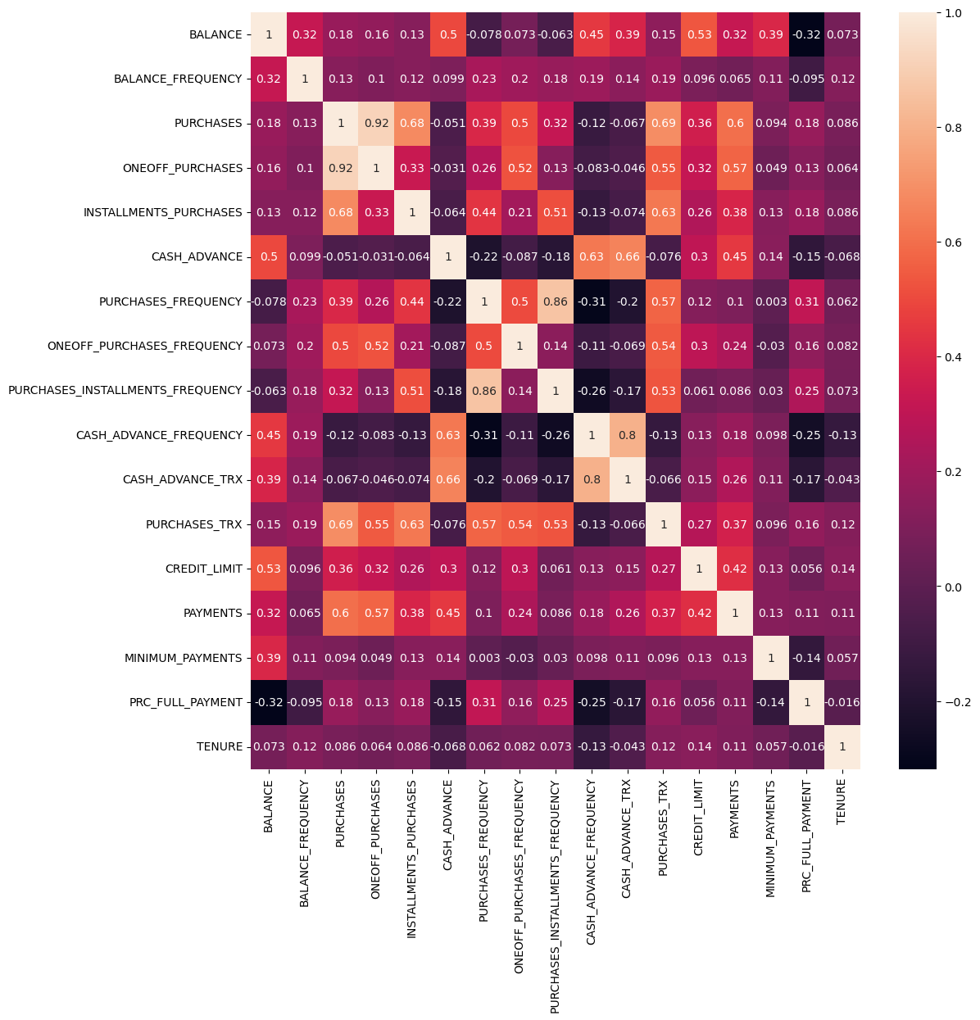
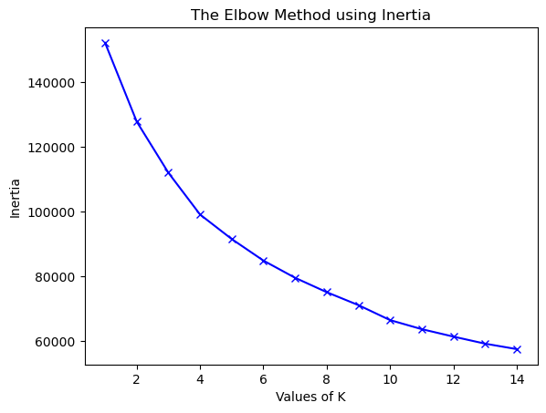
OUTCOMES

Slide 12
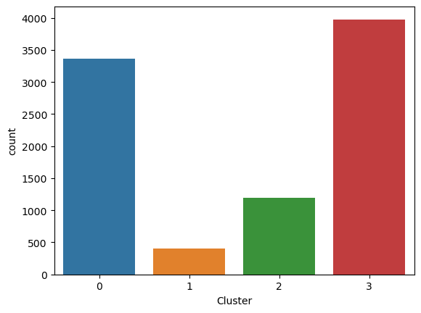
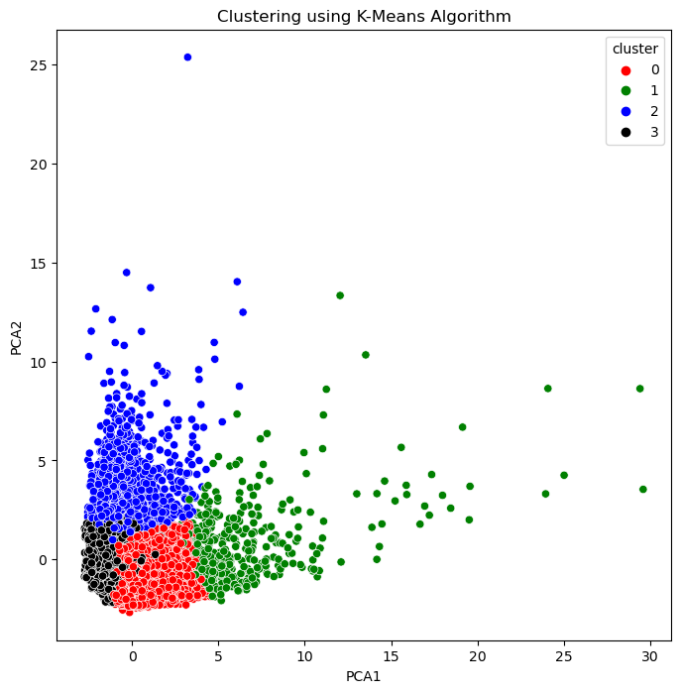
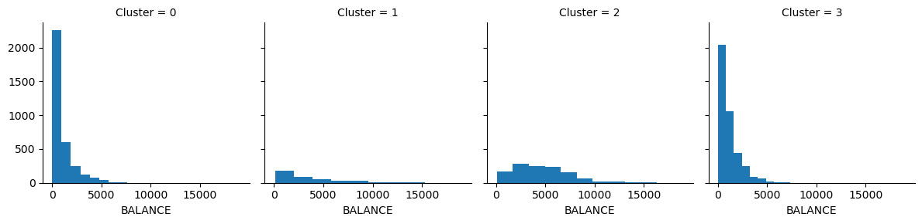

Slide 13
CONCLUSION
In conclusion, Customer segmentation helps companies do better by understanding what different groups of customers want and making products and marketing that fit those wants.
It's like realizing not everyone likes the same things, so companies can be smarter and make customers happier.

Slide 14
REFERENCES
Customer Segmentation using K-means Clustering,
Authors- Tushar Kansal,Suraj Bahuguna,Vishal Singh,Tanupriya Choudhury,
Published Year – 2018
Customer Segmentation using K-Means Clustering
Authors - Nitin Saini, Kapil Sharma, Pradeepta Kumar Sarangi, Gurpreet Singh,
Lekha Rani,Published Year – 2022
Maximizing Strategy in Customer Segmentation Using Clustering Techniques
Authors - M Pavithra, Ayushman Prashar, Abirami, Published Year – 2022

Slide 15
THANK
YOU

